Slide 1
Discrete Mathematics (CSC 1204)
4.1 Mathematical Induction

Slide 2
4.1 Mathematical Induction
Suppose that we have an infinite ladder, and we want to know whether we can reach every step on this ladder.
We know two things –
We can reach the first rung of the ladder
If we can reach a particular rung of the ladder, then we can reach the next rung
Can we conclude that we can reach every rung?

Slide 3
4.1 Mathematical Induction
By (1), we know that we can reach the first rung of the ladder. Moreover, because we can reach the first rung, by (2), we can also reach the second rung; it is the next rung after the first rung.
Applying (2) again, because we can reach the second rung, we can also reach the third rung.
Continuing in this way, we can show that we can reach the fourth rung, the fifth rung, and so on.
For example, after 100 uses of (2), we know that we can reach the 101st rung

Slide 4
4.1 Mathematical Induction
Can we conclude that we are able to reach every rung of this infinite ladder?
Answer: Yes.
We can verify using an important proof technique called mathematical induction
We can show that P(n) is true for every positive integer n, where P(n) is the statement that we can reach the nth rung of the ladder.

Slide 5
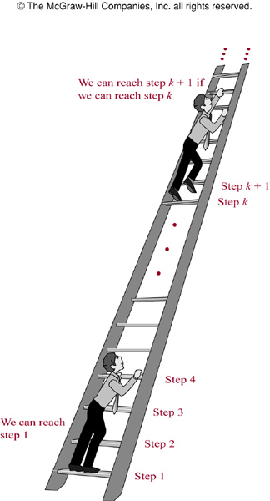
FIGURE 1 : Climbing an Infinite Ladder

Slide 6
4.1 Mathematical Induction
Mathematical induction is an extremely important proof technique that can be used to prove assertions of this type.
Mathematical induction is used extensively to prove results about a large variety of discrete objects.
For example, it is used to prove results about the complexity of algorithms, the correctness of certain types of computer programs, theorems about graphs and trees, as well as a wide range of identities and inequalities

Slide 7
Extremely Important Note!
Mathematical induction can be used only to prove results obtained in some other way. It is not a tool for discovering formulae or theorems.
The principle of mathematical induction is a useful tool for proving that a certain predicate is true for all natural numbers
It cannot be used to discover theorems, but only to prove them

Slide 8
4.1 Mathematical Induction
Principle of Mathematical Induction: To prove that P(n) is true for all positive integers n, where P(n) is a propositional function, we complete two steps:
BASIS STEP: We verify that P(1) is true.
INDUCTIVE STEP : We show that the conditional statement P(k) → P(k+1) is true for all positive integers k
Inductive hypothesis: P(k) is true
[ P(1)∧∀k(P(k) → P(k+1))] → ∀n P(n)

Slide 9
Ways to Remember How Mathematical Induction Works
E.g.
Climbing an infinite ladder
People telling secrets
Infinite row of dominoes

Slide 10
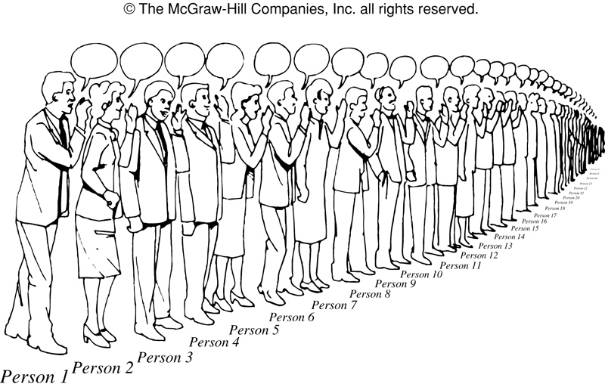
FIGURE 2 : People Telling Secrets

Slide 11
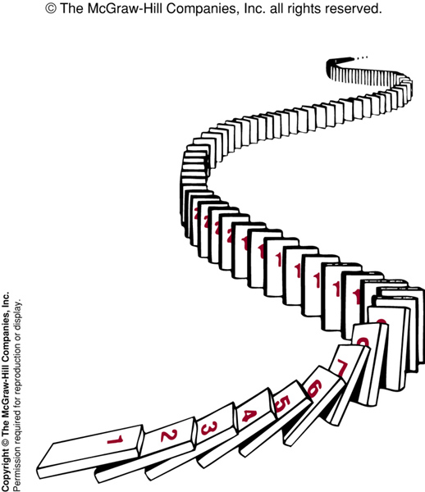
FIGURE 3 Illustrating How Mathematical Induction Works Using Dominoes

Slide 12
Mathematical Induction
If we have a propositional function P(n), and we want to prove that P(n) is true for any natural number n, we do the following:
Show that P(0) is true. (basis step)
Show that if P(n) then P(n + 1) for any n∈N (inductive step)
Then P(n) must be true for any n∈N (conclusion)

Slide 13
Example 1 (page 277)
Example 1: Show that if n is a positive integer, then
1 + 2 + ………. + n = n(n+1)/2
Solution: Let P(n) be the proposition that the sum of the first n positive integers is n(n+1)/2.
We must do two things to prove that P(n) is true for n = 1, 2, 3, ….. Namely, we must show that P(1) is true and that the conditional statement P(k) implies P(k+1) is true for k = 1, 2, 3,
BASIS STEP: P(1) is true, because 1 = 1(1+1)/2
INDUCTIVE STEP: For the inductive hypothesis, we assume that P(k) holds for an arbitrary positive integer k. That is we assume that
1 + 2 + …..+ k = k(k+1)/2 ( INDUCTIVE HYPOTHESIS )

Slide 14
Example 1 (page 277) [cont.]
Under this assumption, it must be shown that P(k+1) is true, namely, that
1 + 2 + ……+ k + (k+1) = (k+1)[(k+1)+1]/2 = (k+1)(k+2)/2 is also true.
Adding (k+1) to both sides of the equation in P(k), we obtain
1 + 2 + ……+ k + (k+1) = k(k+1)/2 + (k+1)
= [k(k+1) + 2(k+1)] / 2
= (k+1)(k+2)/2
This last equation shows that P(k+1) is true under the assumption that P(k) is true. This completes the inductive step.

Slide 15
Example 1 (page 277) [cont.]
We have completed the basis step and inductive step, so by mathematical induction we know that P(n) is true for all positive integers n. That is, we have proven that 1 + 2 + ….+ n = n(n+1)/2 for all positive integers n.

Slide 16
Example 3 (page 279)
Example 3: Use mathematical induction to show that 1 + 2 + 2² + …..+ 2^{n} = 2^{n+1} –1 for all nonnegative integers n.
Solution: Let P(n) be the proposition that 1 + 2 + 2² + …..+ 2^{n} = 2^{n+1} –1 for the integer n.
BASIS STEP: P(0) is true because 2⁰ = 1 = 2¹ –1
INDUCTIVE STEP: For the inductive hypothesis, we assume that P(k) is true.
That is, we assume that 1 + 2 + 2² + …..+ 2^{k} = 2^{k+1} –1
To carry out the inductive step using this assumption, we must show that when we assume that P(k) is true, then P(k+1) is also true. That is we must show that
1 + 2 + 2² + …..+ 2^{k} + 2^{k+1}= 2^{(k+1)+1} –1 = 2^{k+2} –1 , assuming the inductive hypothesis P(k).

Slide 17
Example 3 (page 269) Cont.
Under the assumption of P(k), we see that
1 + 2 + 2² + …..+ 2^{k} + 2^{k+1} = (1 + 2 + 2² + …..+ 2^{k} )+ 2^{k+1}
= (2^{k+1} –1 )+ 2^{k+1}
= 2. 2^{k+1} – 1
= 2^{k+2} – 1
Because we have completed the basis step and the inductive step, by mathematical induction we know that P(n) is true for all nonnegative integers n. That is, 1 + 2 + 2² + …..+ 2^{n} = 2^{n+1} –1 for all nonnegative integers n.

Slide 18
Example 5 (page 281)
Example 5: Use mathematical induction to prove the inequality
n < 2^{n} for all positive integers n.
Solution: Let P(n) be the proposition that n < 2^{n} .
BASIS STEP: P(1) is true, because 1 < 2¹ = 2
INDUCTIVE STEP: Assume P(k) is true for all positive integer k, that is, k < 2^{k} (Inductive Hypothesis)
We need to show that if k < 2^{k} , then k+1 < 2^{k+1}
Now, k + 1 < 2^{k} + 1 [adding 1 to both sides of k < 2^{k} ] ≤ 2^{k} + 2^{k} = 2. 2^{k} = 2^{k+1} [ note: 1 ≤ 2^{k} ]
This shows that P(k+1) is true, i.e., k+1 < 2^{k+1}
Because we have completed both the basis step and the inductive step, by the principle of mathematical induction we have shown that n < 2^{n} is true for all positive integers n.

Slide 19
Practice @ Home
Exercise: 3, 5, 7

Slide 20
Modified Exercise 3 (p.289)
Modified Exercise 3: Use mathematical induction to show that
1² + 2² + …..+ n² = n (n+1)(2n+1) / 6 for all positive integers n.
Solution: Let P(n) be the proposition 1² + 2² + …..+ n² = n (n+1)(2n+1)/6 BASIS STEP: P(1) is true, because 1² = 1.2.3/6
INDUCTIVE STEP: We assume that 1² + 2² + …..+ k² = k(k+1)(2k+1)/6
(Inductive Hypothesis)
We want to show that 1² + 2² + …..+ k² + (k + 1)²= (k+1)(k+2)(2k+3)/6
Now, 1² + 2² + …..+ k² + (k + 1)² = k(k+1)(2k+1)/6 + (k + 1)²
= (k+1)/6 [k(2K+1) + 6(K+1)]
= (k+1)/6 [2k² +7k + 6]
= (k+1)/6 [2k² + 4k + 3k+ 6]
= (k+1)/6 [2k² + 4k + 3k+ 6]
= (k+1)(k+2)(2k+3)/6
So, inductive step is true.
Therefore, 1² + 2² + …..+ n² = n (n+1)(2n+1)/6 for all positive integers n.

Slide 21
Exercise 5 (p.289)
Exercise 5: Prove that 1² + 3² + 5² + …..+ (2n+1)² = (n+1)(2n+1)(2n+3)/3
whenever n is a nonnegative integer.
Sol.: Let P(n) be the proposition 1² + 3² + 5² +…..+ (2n+1)² = (n+1)(2n+1)(2n+3)/3
BASIS STEP: P(0) is true, because 1² = 1.1.3/3
INDUCTIVE STEP: We assume that 1² + 3² + 5² + …..+ (2k+1)² = (k+1)(2k+1)(2k+3)/3 (Inductive Hypothesis)
We want to show that 1² + 3² + 5² + …..+ (2k+1)² + (2k+3)² = (k+2)(2k+3)(2k+5)/3
Now, (1² + 3² + 5² + …..+ (2k+1)² ) + (2k+3)² = (k+1)(2k+1)(2k+3)/3 + (2k+3)²
= (2k+3)/3 [ (k+1)(2k+1) + 3(2k+3) ]
= (2k+3)/3 [ (2k² + 3k + 1) + (6k + 9)]
= (2k+3)/3 [ 2k² + 9k + 10 ]
= (2k+3)/3 [2k² + 4k + 5k + 10 ] = (2k+3)/3 [2k(k+2) + 5(k+2)]
= (k+2)(2k+3)(2k+5)/3
Therefore inductive step is true
So, 1² + 3² + 5² + …..+ (2n+1)² = (n+1)(2n+1)(2n+3)/3, whenever n is a nonnegative integer

